Slide 1



The Winds of Change: How Do Galactic Winds Evolve Over Time?
Nicole Kerrison
Mentor: Ann Zabludoff

Slide 2
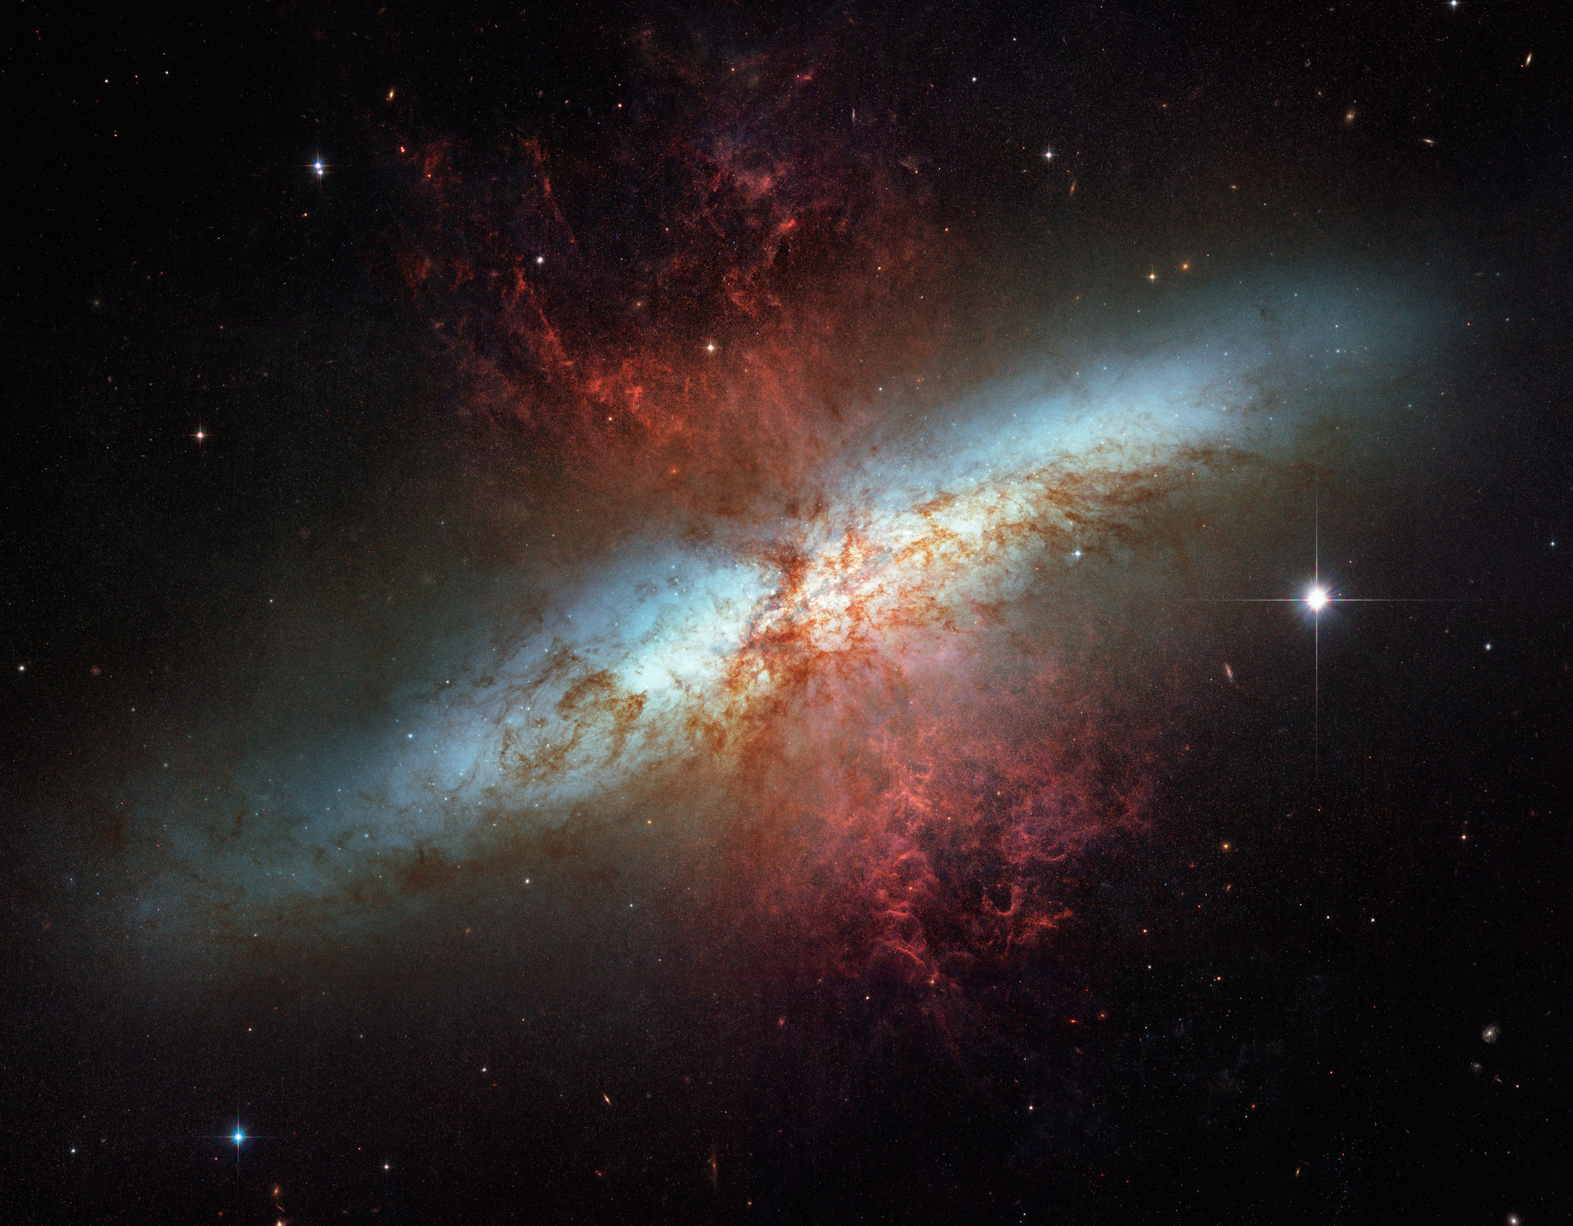
Galactic Winds
Also known as “outflows” and “feedback”
High velocity gas and dust particles ejected from a galaxy
Manifest from
Intense star formation (“starbursts”)
Exploding stars (“supernovae”)
Central black holes
M82

Slide 3
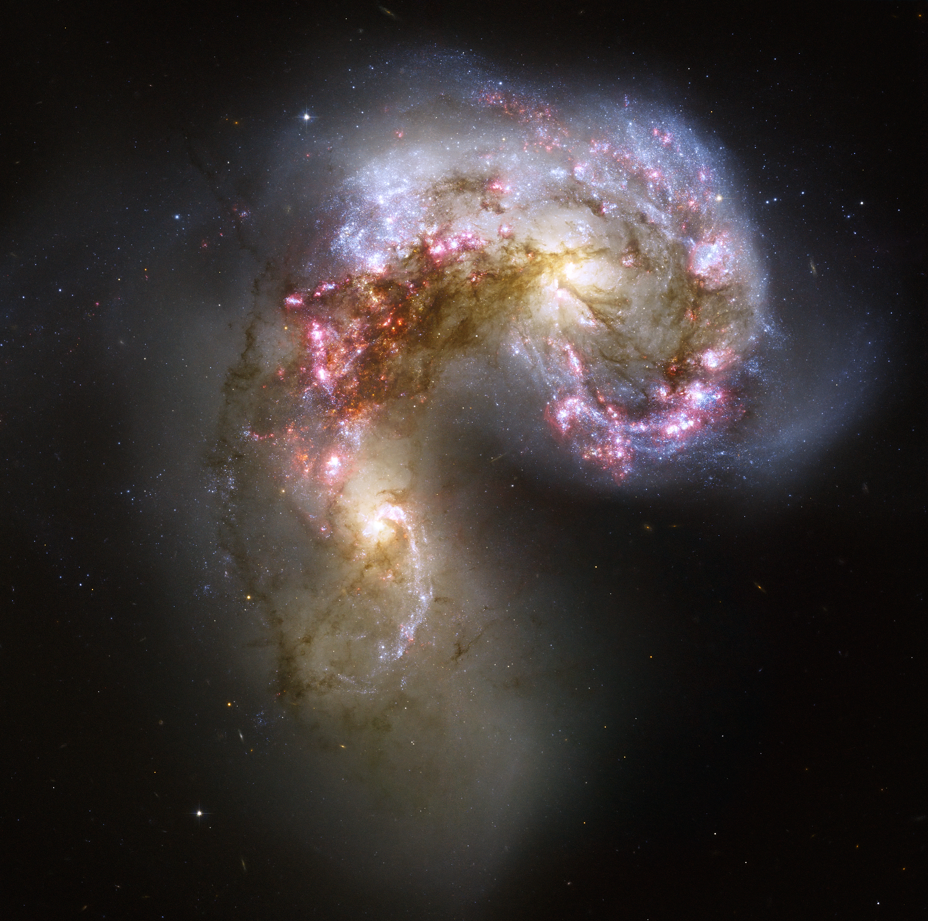
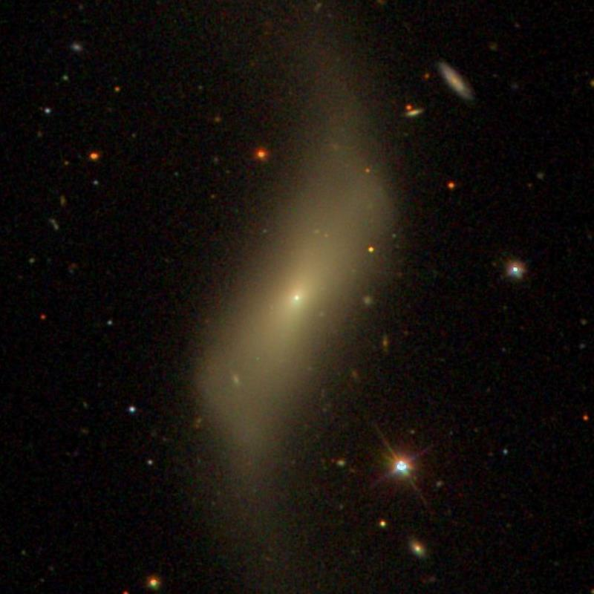
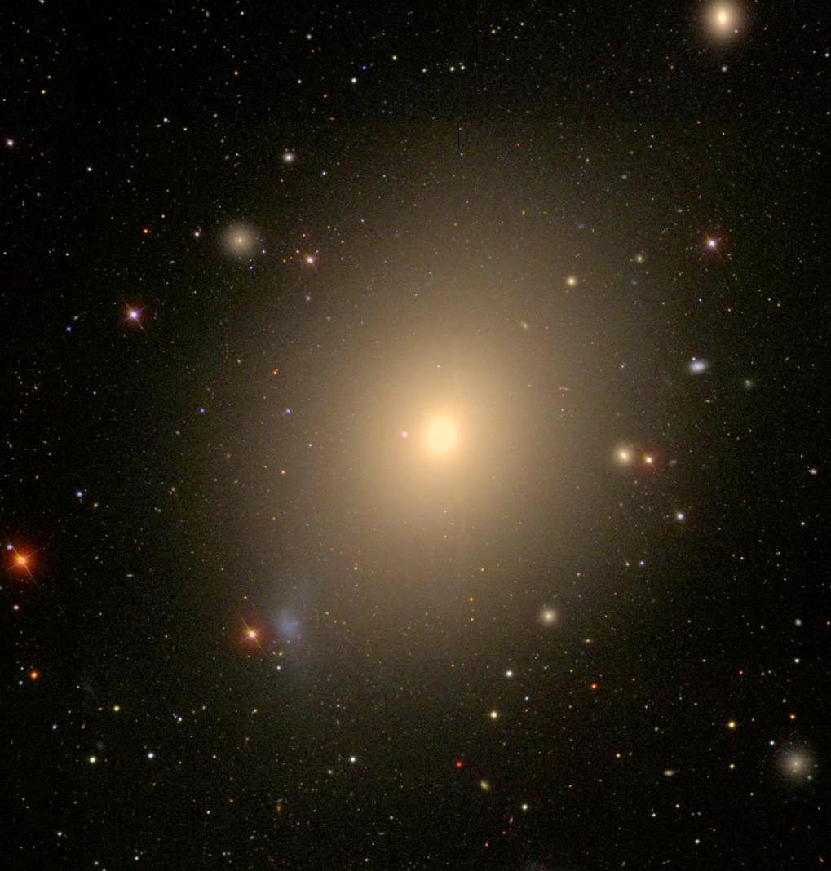
An Evolutionary Sequence
Actively Star Forming
Recently Star Forming
No Longer Star Forming
NGC 4038 / NGC 4039
NGC 4488
NGC 4472

Slide 4
Role of Galactic Winds in Galaxy Evolution
lots of star formation = winds
winds = depleting gas
no gas = no star formation
depleting gas
depleting gas
new & old stars
old stars only

Slide 5
Methods
Tracers of outflowing and inflowing gas within a galaxy.
Offset analogous to doppler shifts.
Began with star forming, recently star forming, and no longer star forming samples.
Contain wind velocities and errors for each galaxy.
How does wind velocity differ between these three samples?
Use Python and Python packages: pandas, Matplotlib, and SciPy.

Slide 6
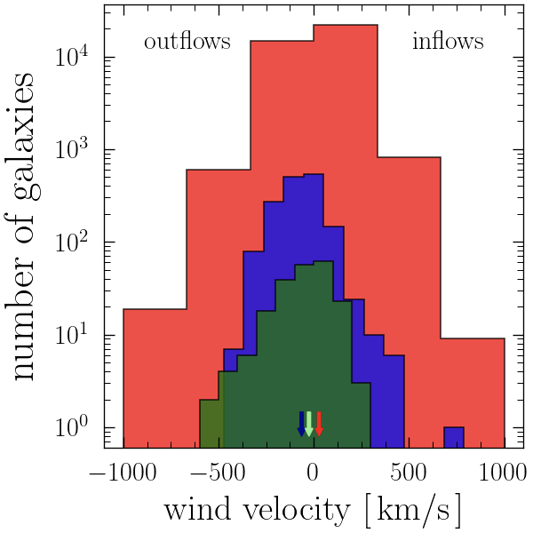
Distribution of Wind Speeds
The average offset moves from outflow to inflow along the galaxy evolution sequence, from star forming, to recently star forming, to not star forming galaxies.
Key:
Actively Star Forming
Recently Star Forming
No Longer Star Forming
wind speeds decrease

Slide 7
Summary
Galactic winds are generated by star birth, star death, and black holes in the centers of galaxies.
Lots of star formation leads to winds… winds lead to depleting gas… without gas, stars no longer form.
Winds declining along galaxy evolutionary sequence support this model.
What’s Next?

Slide 8
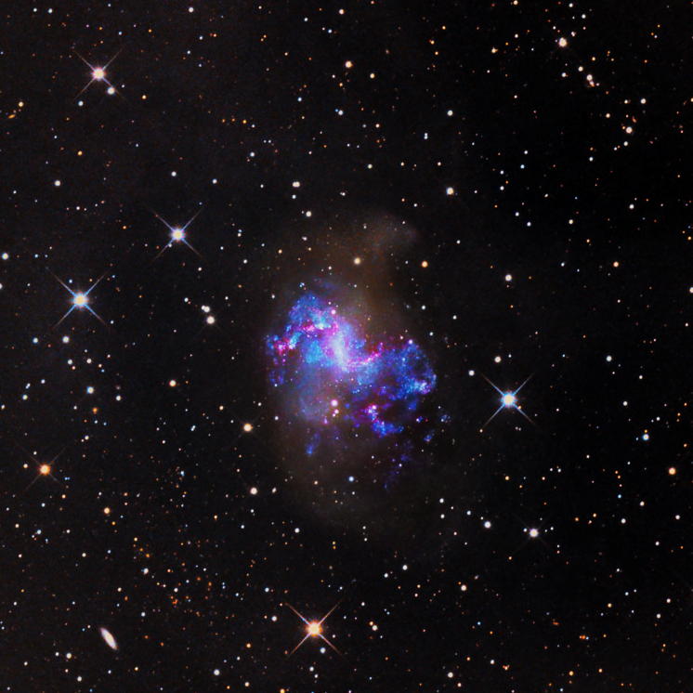
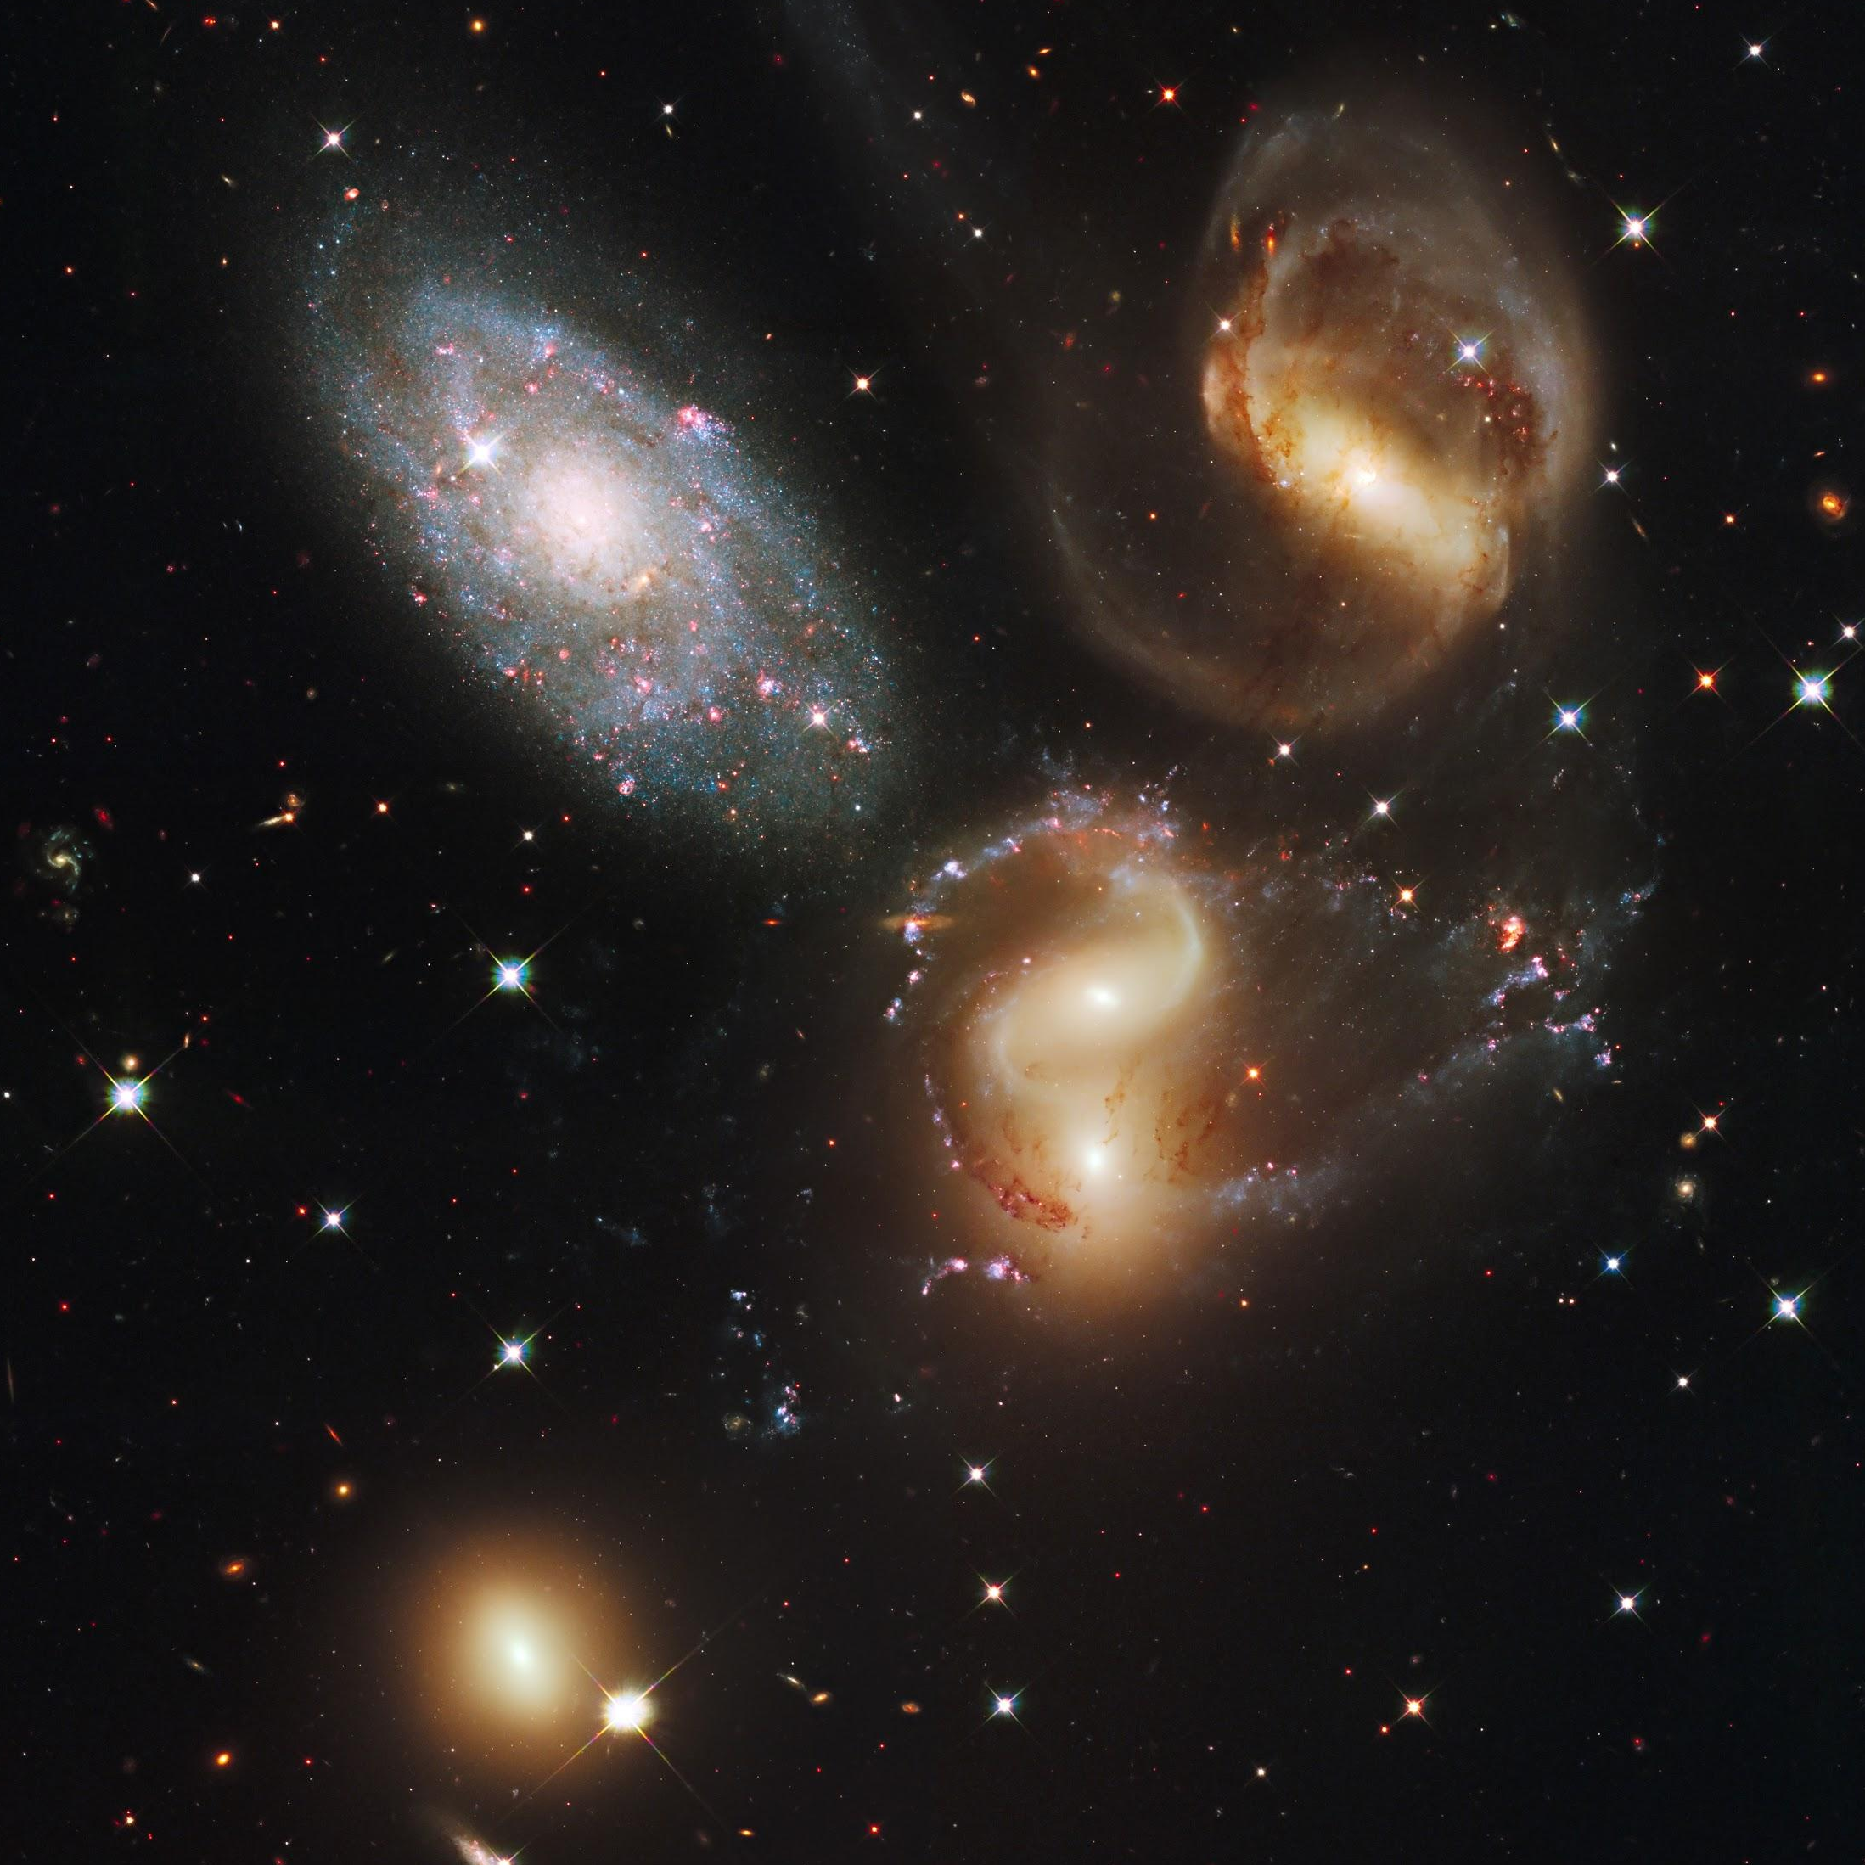
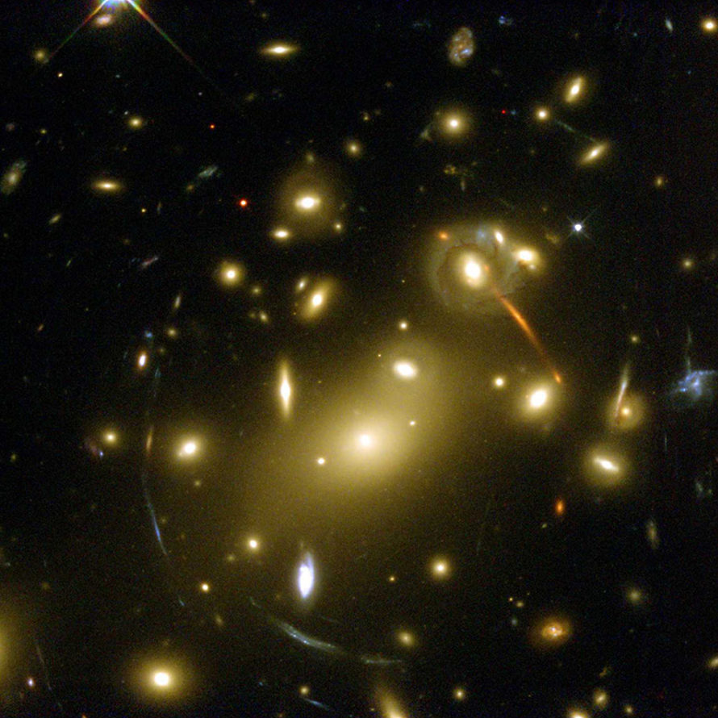
Galactic Environments
galaxy density increases
Field
Group
Cluster
NGC 1313
Stephan’s Quintet
Abell 2218

Slide 9
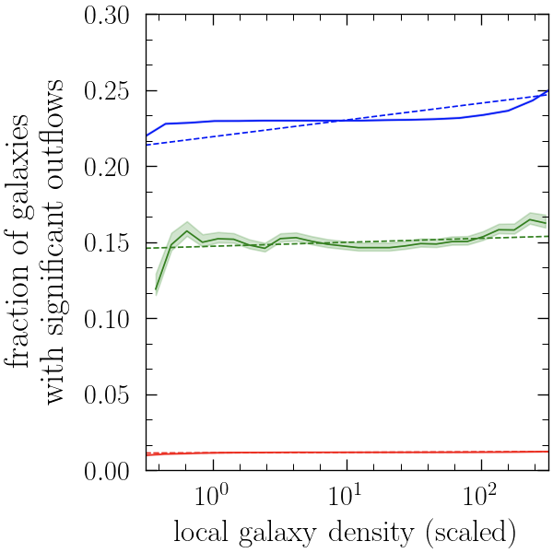
Galactic Winds Versus Environment
Winds decrease along galaxy evolution sequence and, for each galaxy class, increase with local galaxy density.
More clumped, stronger winds. Explain increase in metals?
Key:
winds decrease with galaxy evolution
Actively Star Forming
Recently Star Forming
No Longer Star Forming
winds increase with environment

Slide 10
Thank You!
Dr. Ann Zabludoff — Project Mentor
Michelle Coe — Program Manager
Arizona Space Grant Consortium and UA/NASA Space Grant Program
The material contained in this document is based upon work supported by a National Aeronautics and Space Administration (NASA) grant or cooperative agreement. Any opinions, findings, conclusions or recommendations expressed in this material are those of the author and do not necessarily reflect the views of NASA. This work was supported through a NASA grant awarded to the Arizona/NASA Space Grant Consortium.

Slide 11
Image Credits
M82 — NASA, ESA and the Hubble Heritage Team (STScI/AURA)
NGC 4038 / NGC 4039 — NASA, ESA, and the Hubble Heritage Team (STScI/AURA)
NGC 4488 — Sloan Digital Sky Survey
NGC 4472 — Sloan Digital Sky Survey
NGC 1313 — Velimir Popov & Emil Ivanov
Stephan’s Quintet — NASA, ESA, and the Hubble SM4 ERO Team
Abell 2218 — NASA, Andrew Fruchter and the ERO Team

